Slide 1


Slide 2

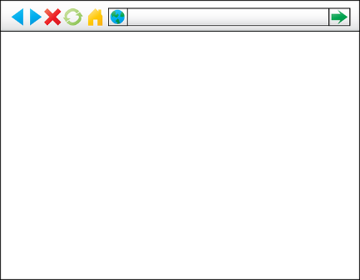
Model View Controller
Data
Database Utility Classes (model)
Servlet
Oracle Database (Model)
Controller
Entity Classes (Model)
Java
Java Server Pages (JSP)
(view)
Browser
(view)

Slide 3
Bullhorn
Data
Database Utility Classes (model)
Entity Classes (Model)
Oracle Database (Model)
Servlet
Java
Java Server Pages (JSP)
(view)
Controller
Java
Servlet
Java
Java Server Pages (JSP)
(view)
Java Server Pages (JSP)
(view)
Servlet
Controller
Controller
Browser
(view)

